Slide 1
UNIT 3

Slide 2
Unified Modeling Language
UML, short for Unified Modeling Language, is a standardized modeling language consisting of an integrated set of diagrams, developed to help system and software developers for specifying, visualizing, constructing, and documenting the artifacts of software systems, as well as for business modeling and other non-software systems.
The UML represents a collection of best engineering practices that have proven successful in the modeling of large and complex systems. The UML is a very important part of developing object oriented software and the software development process.
The UML uses mostly graphical notations to express the design of software projects.
Using the UML helps project teams communicate, explore potential designs, and validate the architectural design of the software.

Slide 3
Need for UML
As the strategic value of software increases for many companies, the industry looks for techniques to automate the production of software and to improve quality and reduce cost and time-to-market.
These techniques include component technology, visual programming, patterns and frameworks. Businesses also seek techniques to manage the complexity of systems as they increase in scope and scale.
In particular, they recognize the need to solve recurring architectural problems, such as physical distribution, concurrency, replication, security, load balancing and fault tolerance.

Slide 4
Contd…
The Unified Modeling Language (UML) was designed to respond to these needs. The primary goals in the design of the UML as follows:
Provide users with a ready-to-use, expressive visual modeling language so they can develop and exchange meaningful models.
Provide extensibility and specialization mechanisms to extend the core concepts.
Be independent of particular programming languages and development processes.
Provide a formal basis for understanding the modeling language.
Encourage the growth of the OO tools market.
Support higher-level development concepts such as collaborations, frameworks, patterns and components.
Integrate best practices.

Slide 5
Static Model and Dynamic Model
Static models, such as UML class diagrams, help design the definition of packages, class names, attributes, and method signatures (but not method bodies).
Dynamic models, such as UML interaction diagrams (sequence diagrams or communication diagrams), help design the logic, the behavior of the code or the method bodies. They tend to be the more interesting, difficult, important diagrams to create.

Slide 6
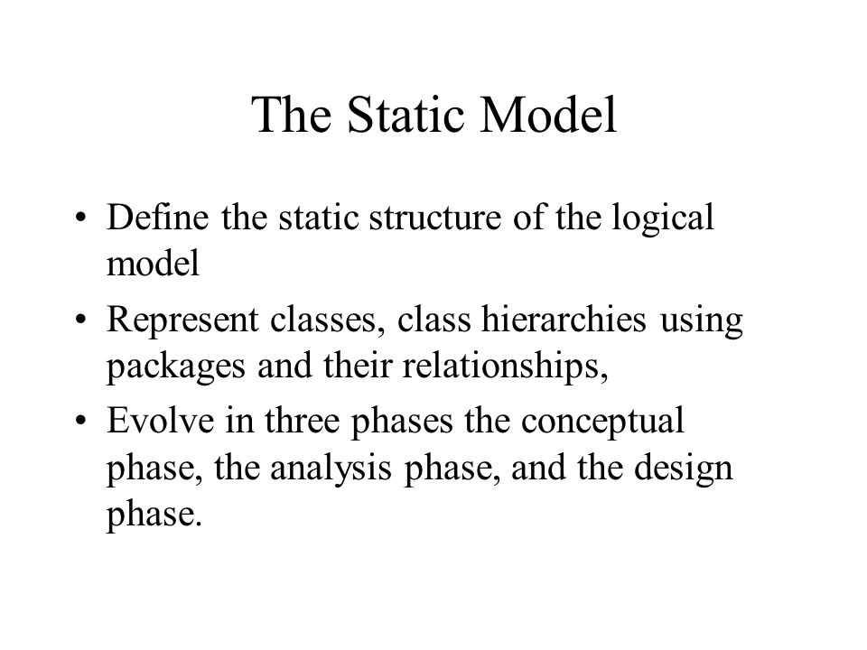

Slide 7
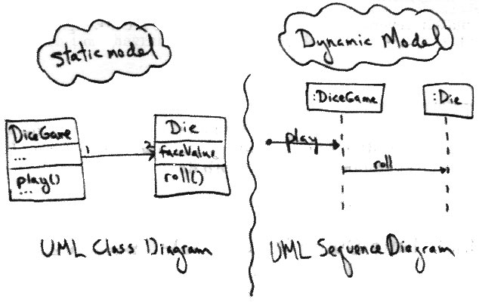

Slide 8
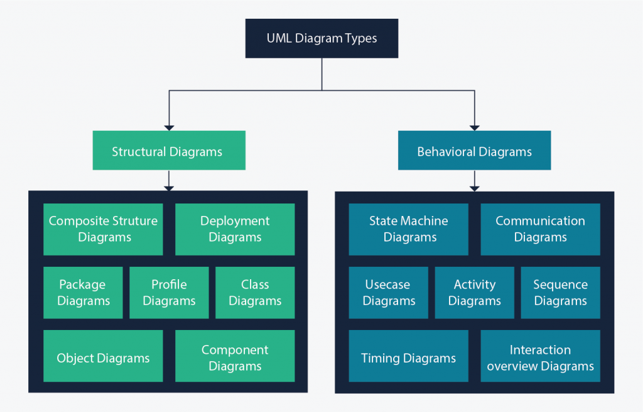
UML diagram Types

Slide 9
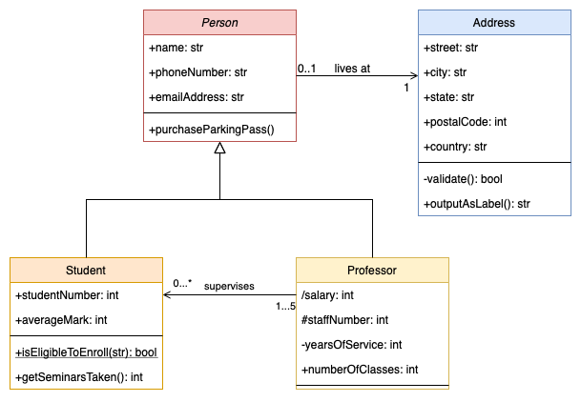
Class diagram

Slide 10
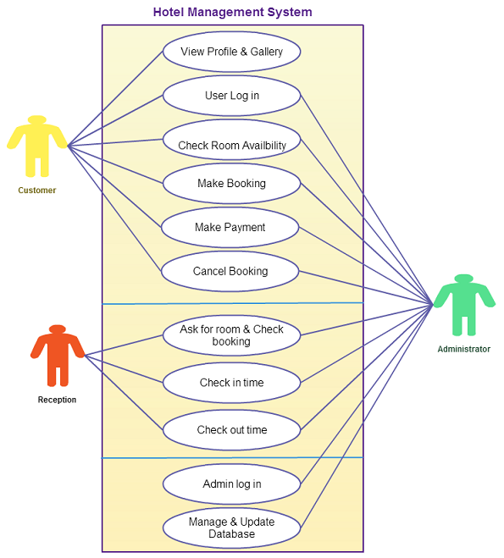

Slide 11
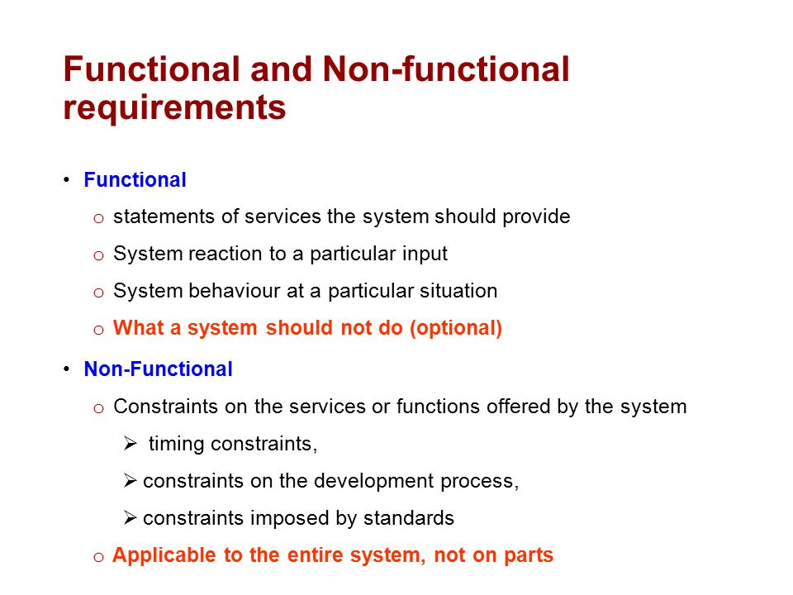

Slide 12
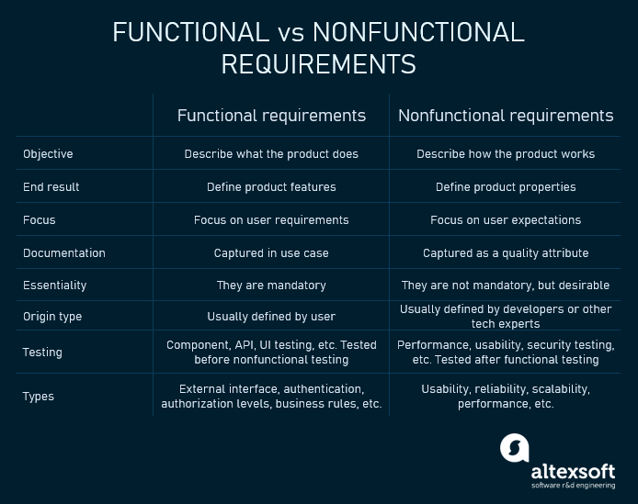

Slide 13
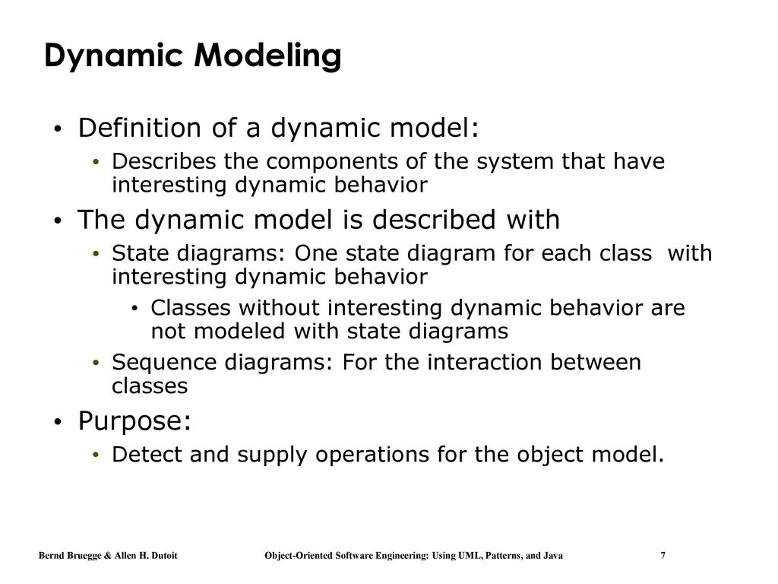

Slide 14
INTERACTION DIAGRAMS
The purpose of interaction diagrams is to visualize the interactive behavior of the system. Visualizing the interaction is a difficult task. Hence, the solution is to use different types of models to capture the different aspects of the interaction.
The purpose of interaction diagram is −
To capture the dynamic behaviour of a system.
To describe the message flow in the system.
To describe the structural organization of the objects.
To describe the interaction among objects.

Slide 15
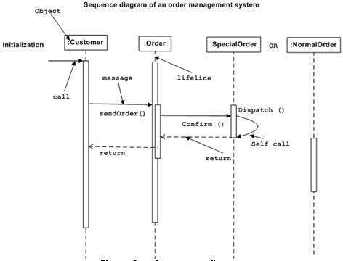

Slide 16
Statechart diagram
Statechart diagram is one of the five UML diagrams used to model the dynamic nature of a system. They define different states of an object during its lifetime and these states are changed by events.
Statechart diagrams are useful to model the reactive systems. Reactive systems can be defined as a system that responds to external or internal events.
Statechart diagram describes the flow of control from one state to another state. States are defined as a condition in which an object exists and it changes when some event is triggered.

Slide 17
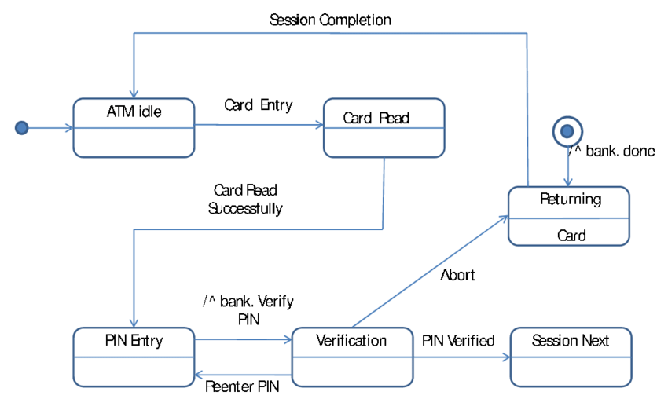
State Diagram

Slide 18
Activity Diagram
Activity diagram is basically a flowchart to represent the flow from one activity to another activity. The activity can be described as an operation of the system.
he control flow is drawn from one operation to another. This flow can be sequential, branched, or concurrent. Activity diagrams deal with all type of flow control by using different elements such as fork, join, etc
The purpose of an activity diagram can be described as −
Draw the activity flow of a system.
Describe the sequence from one activity to another.
Describe the parallel, branched and concurrent flow of the system.

Slide 19
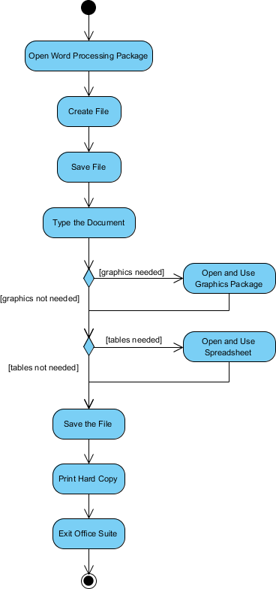

Slide 20
Implementation Diagram
The two types of implementation diagrams are component diagrams and deployment diagrams.
Component diagrams are modeled to illustrate relationship between piece of software, while deployment diagram are modeled to illustrate relationships between piece of hardware.
A component diagram is used to break down a large object-oriented system into the smaller components, so as to make them more manageable. It models the physical view of a system such as executables, files, libraries, etc. that resides within the node.
The purpose of the component diagram can be summarized as −
Visualize the components of a system.
Construct executables by using forward and reverse engineering.
Describe the organization and relationships of the components.

Slide 21
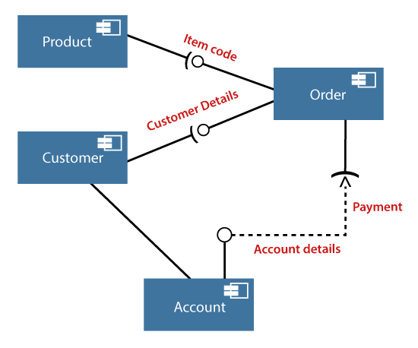

Slide 22
Deployment diagram
Deployment diagram represents the deployment view of a system. It is related to the component diagram because the components are deployed using the deployment diagrams. A deployment diagram consists of nodes. Nodes are nothing but physical hardware used to deploy the application.
Deployment diagrams are useful for system engineers. An efficient deployment diagram is very important as it controls the following parameters
Performance
Scalability
Maintainability
Portability

Slide 23
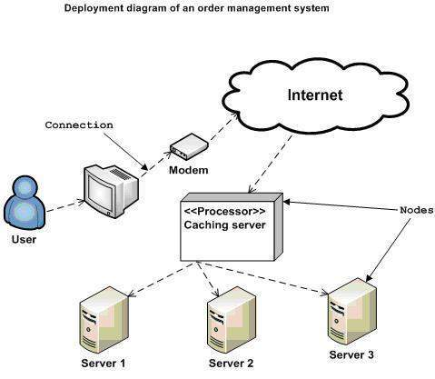

Slide 24
Deployment diagrams can be used −
To model the hardware topology of a system.
To model the embedded system.
To model the hardware details for a client/server system.
To model the hardware details of a distributed application.
For Forward and Reverse engineering.

